Slide 1
File Handling in Python
M.R.Solanki,
Sr. Lecturer, SBMP,
Information Technology Department

Slide 2
File Handling
Python too supports file handling and allows users to handle files i.e., to read and write files, along with many other file handling options, to operate on files.
Python treats files differently as text or binary and this is important.
Each line of code includes a sequence of characters and they form a text file. Each line of a file is terminated with a special character, called the EOL or End of Line characters like comma {,} or newline character. It ends the current line and tells the interpreter a new one has begun.

Slide 3
Working of open() function
Before performing any operation on the file like reading or writing, first, we have to open that file. For this, we should use Python’s inbuilt function open() but at the time of opening, we have to specify the mode, which represents the purpose of the opening file.
f = open(filename, mode)
Where the following mode is supported:
r: open an existing file for a read operation.
w: open an existing file for a write operation. If the file already contains some data then it will be overridden.
a: open an existing file for append operation. It won’t override existing data.
r+: To read and write data into the file. The previous data in the file will be overridden.
w+: To write and read data. It will override existing data.
a+: To append and read data from the file. It won’t override existing data.
x : Create - will create a file, returns an error if the file exist

Slide 4
Working of open() function
"t" - Text - Default value. Text mode
"b" - Binary - Binary mode (e.g. images/audio/video)
f = open("demofile.txt", "rt")

Slide 5
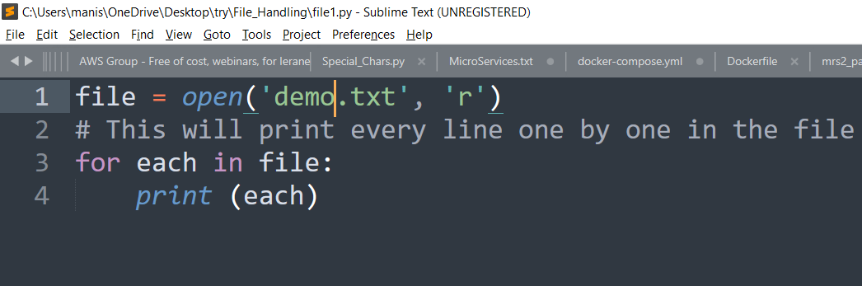
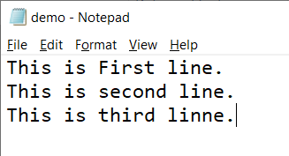
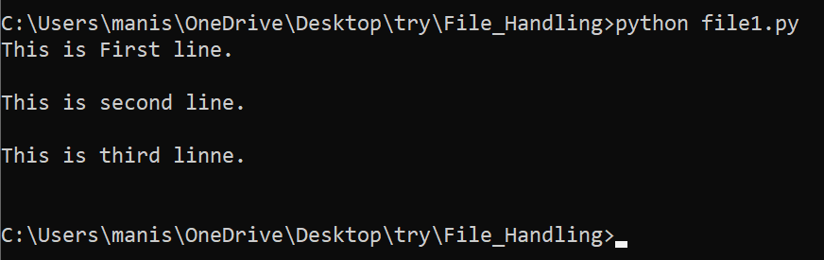

Slide 6
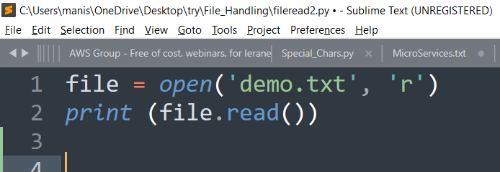
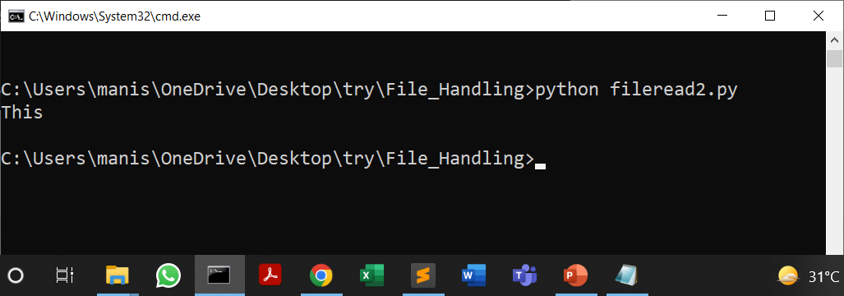
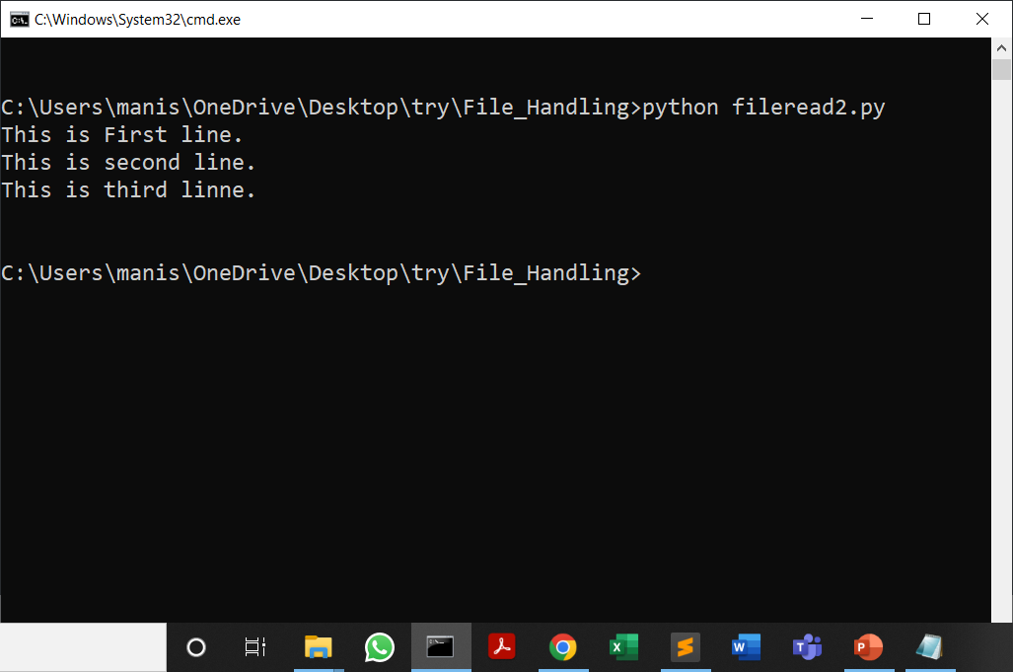
file = open('demo.txt', 'r')
print (file.read(5))

Slide 7
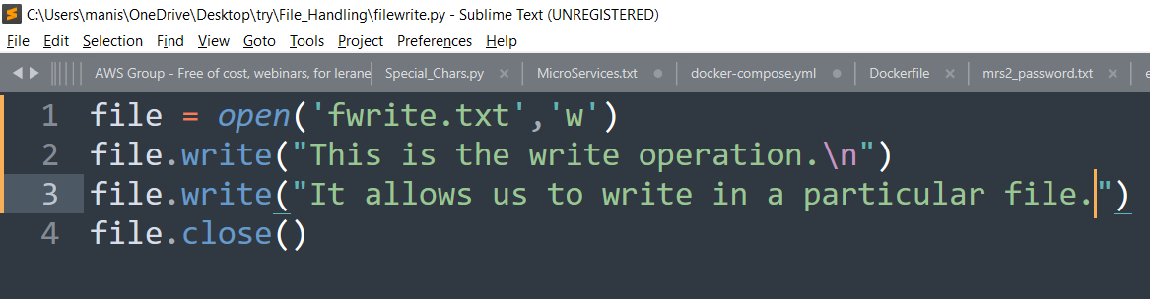
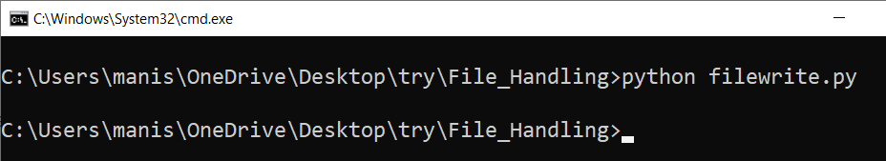
Creating a file using write() mode

Slide 8
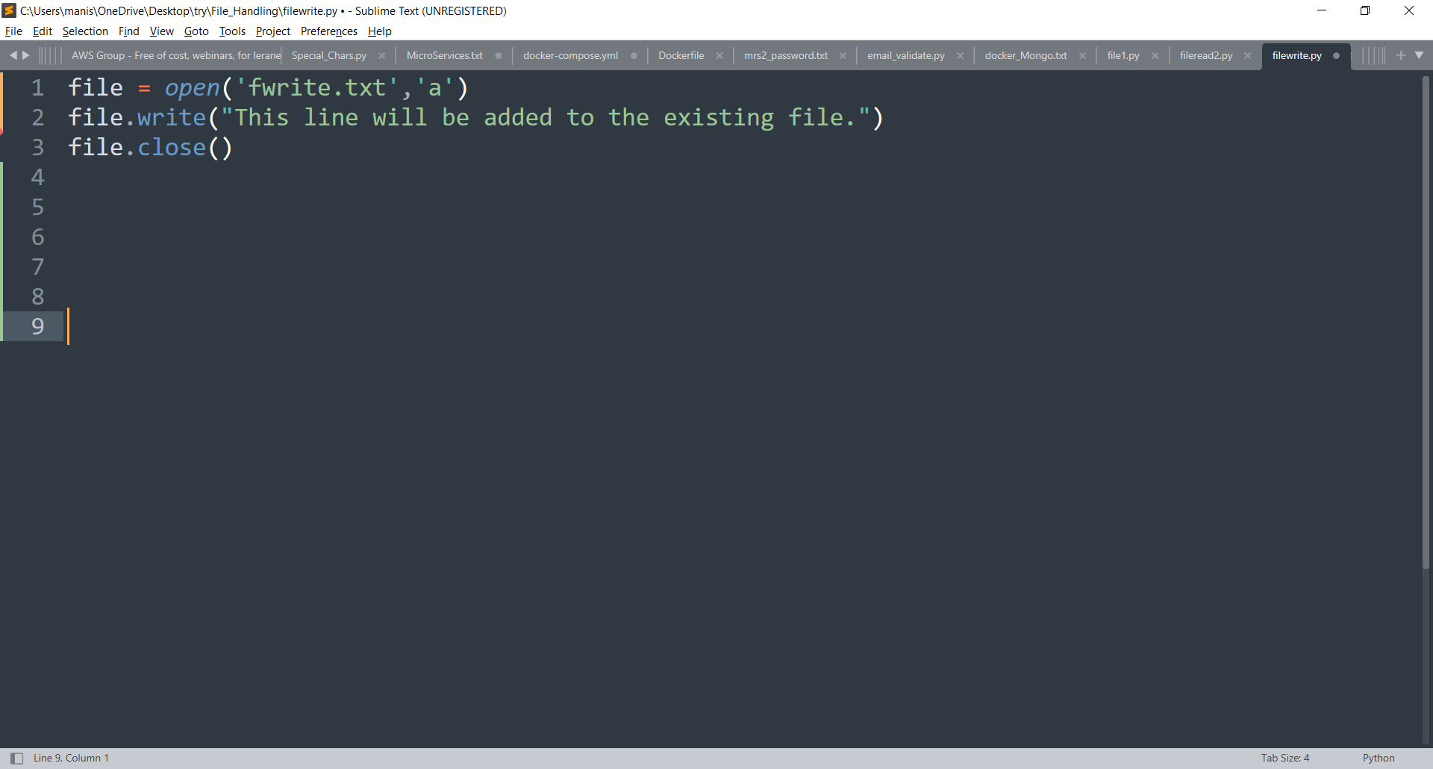
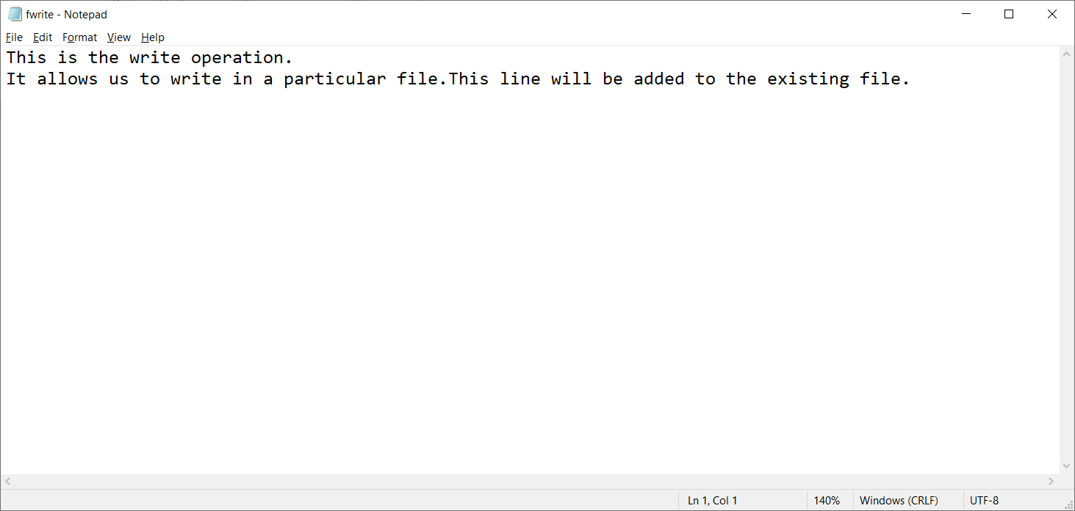
write() with append mode

Slide 9
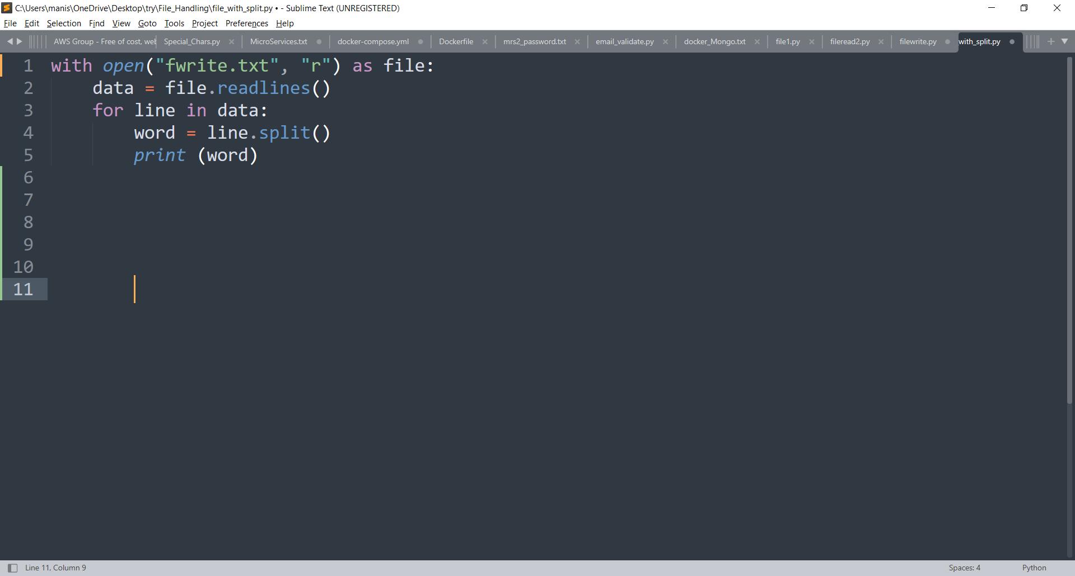
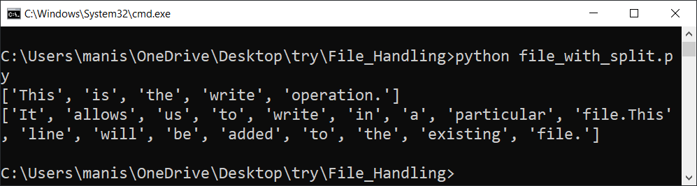
Using write along with the with() & split() function

Slide 10
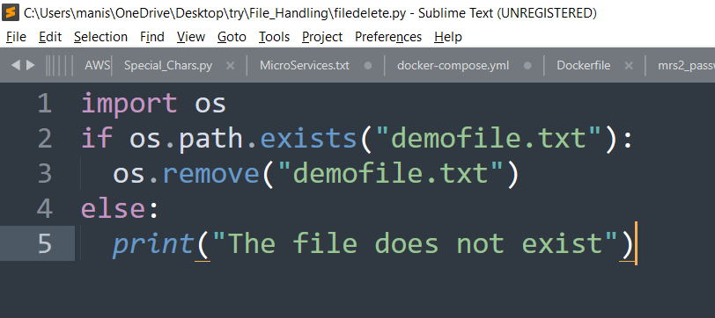
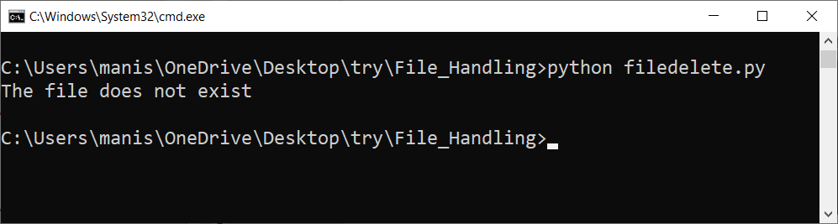
Deleting the files

Slide 11
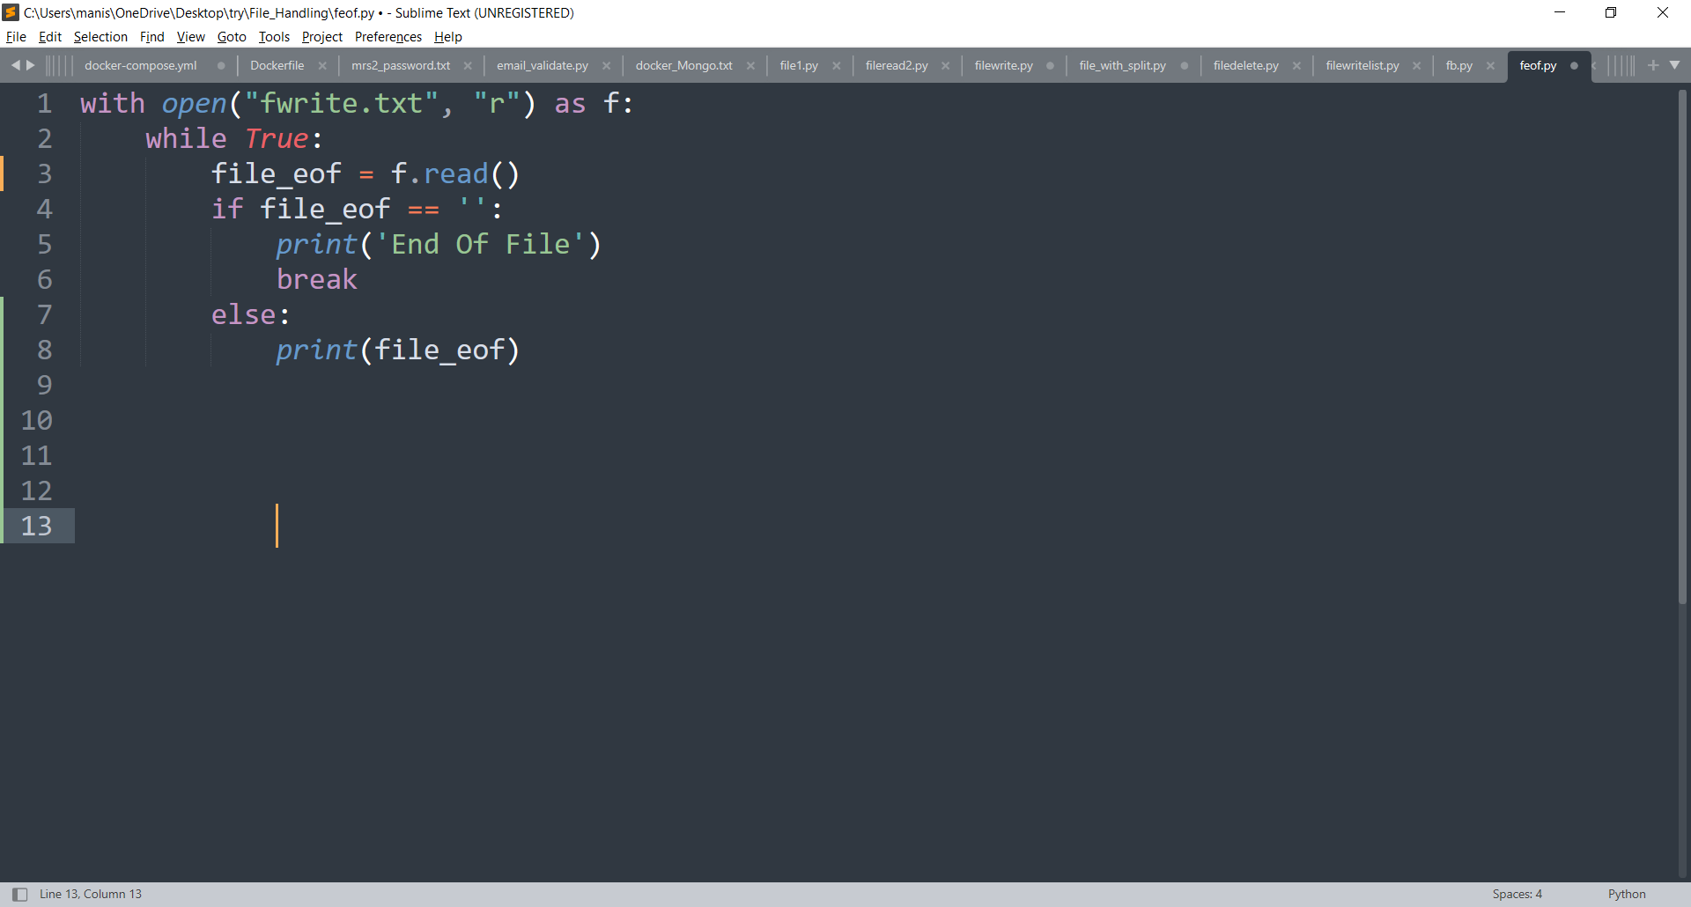
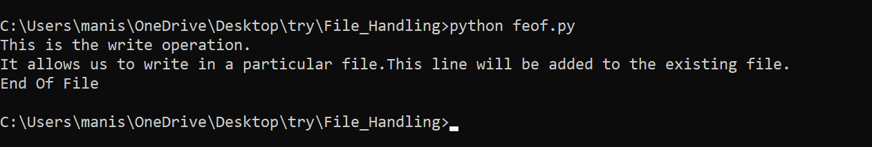
Reading file till EOF

Slide 12
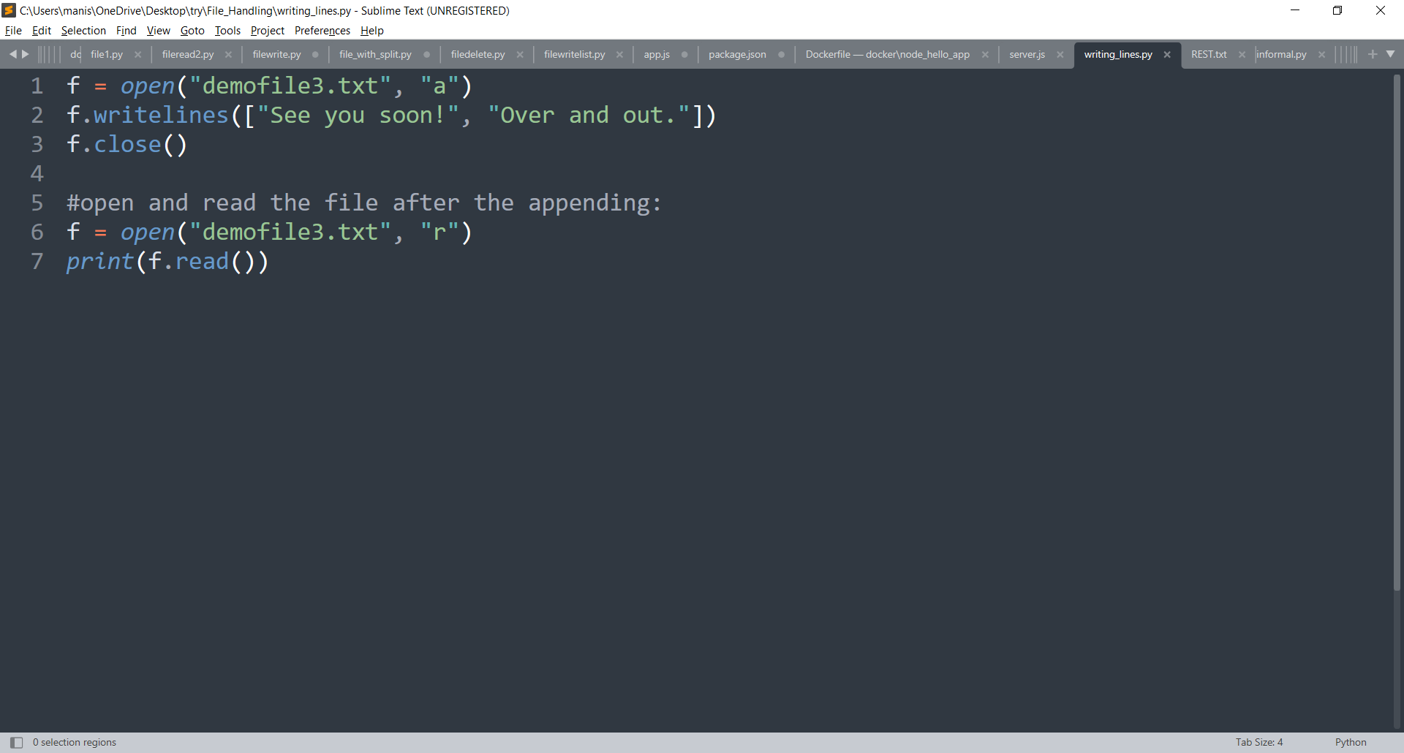
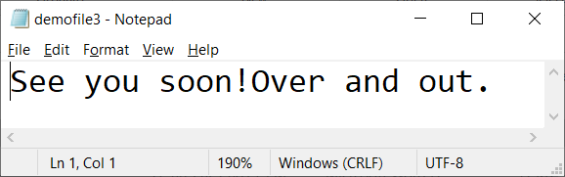
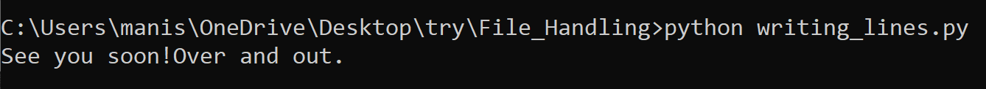
writelines() method
The writelines() method writes the items of a list to the file.

Slide 13
Exercise
Write a Python script to copy the content of one file to other file.

Slide 16
References
https://www.geeksforgeeks.org/file-handling-python/
https://www.softwaretestinghelp.com/python/python-file-reading-writing/

